Slide 1
Temple Isaiah
Modernism Week

Slide 2
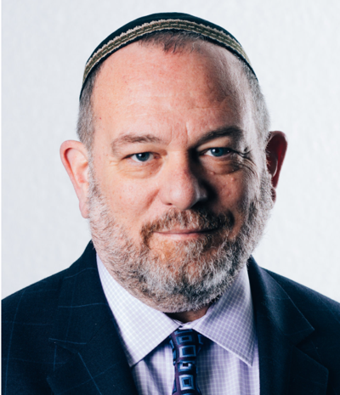
Rabbi David Lazar welcomes you
Architects and artists throughout history, from the biblical Bezalel to the Palm Springs modernists, have used a wide variety of materials, techniques and styles to create sacred space.
Temple Isaiah is proud to welcome you to experience our sacred spaces.

Slide 3
“My Way” and “Our Way” – architects, artists, Frank Sinatra and the Jewish people
Temple Isaiah celebrates “our way” - our unique facilities, which reflect deep-rooted Jewish tradition in a Palm Springs setting.
Each architect and artist "planned each chartered course, each careful step along the biway”
Over the years many, including Frank Sinatra, helped make the efforts possible.

Slide 4
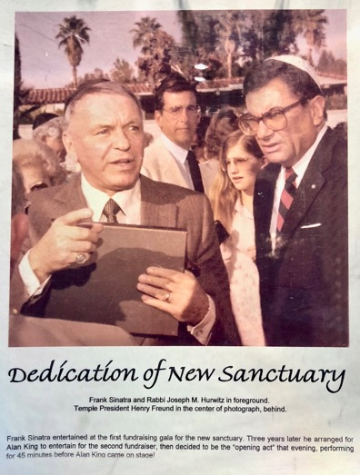
Frank Sinatra, Temple Isaiah benefactor, and Rabbi Joseph Hurwitz, a Palm Springs personality
Sinatra helped raise the funds for the Bochner sanctuary
Rabbi Hurwitz served Temple Isaiah from 1958 to 1998

Slide 5
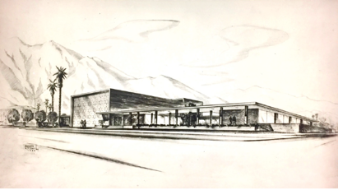
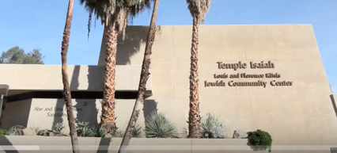
Temple Isaiah’s architecture uses changing styles and materials to create sacred spaces
Three key elements of synagogue architecture:
The Torah
The Eternal Light
The Ark

Slide 6
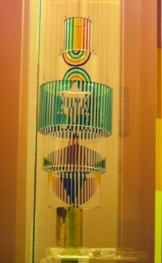
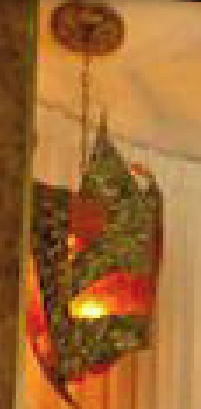
Eternal Lights
Commanded in the Torah (Exodus 27:20-21), they symbolize God's eternal presence and are therefore never extinguished.
Bochner sanctuary
Original
Liberman
chapel
Updated
Liberman
chapel

Slide 7
The Torah in the ark is the central focus of synagogue design
The Torah is the parchment scroll containing the five books of Moses. It is read on the Sabbath and Jewish holidays

Slide 8
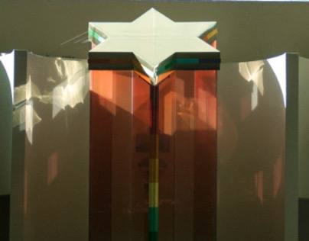
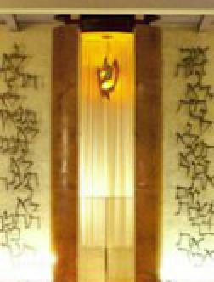
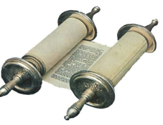
Torah arks across the years
In the synagogue, the ark holds the Torah scrolls
Bochner sanctuary
Original Liberman chapel
Updated Liberman chapel

Slide 9
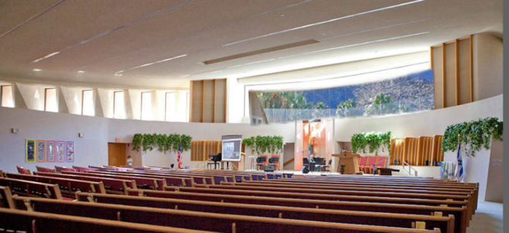
The historic Modernist E. Stewart Williams structure (left) is contrasted with the 1980’s west facing addition, designed by David Christian (right).

Slide 10
Original Liberman chapel – designed by E. Stewart Williams in 1947
The original building consisted of a sanctuary and community center, as well as offices, library, and a central patio. Materials were humble--poured concrete, cinderblock, wood ceilings, and brick.
The chandeliers were later
to be removed.

Slide 11
Updated chapel – circa 1960-1969
Changes were made to enhance worship:
Eternal Light
Ark
Hebrew letters of the 10 Commandments
Stained glass windows
Lectern

Slide 12
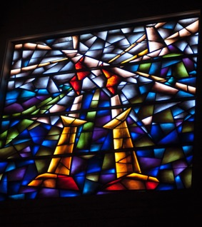
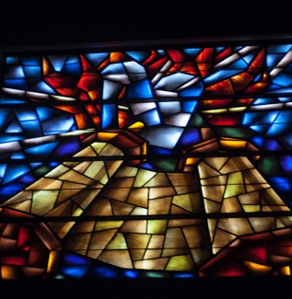
Stained glass windows
Stained glass windows in the Liberman chapel, installed in 1969 and designed by Eric Ray, who was educated in London on modern Jewish synagogue art

Slide 13
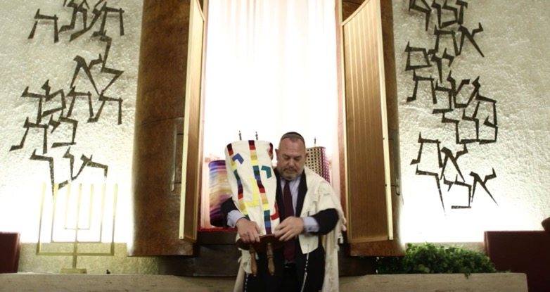
10 Commandments in Hebrew calligraphy were done by German metal artist Victor Ries

Slide 14
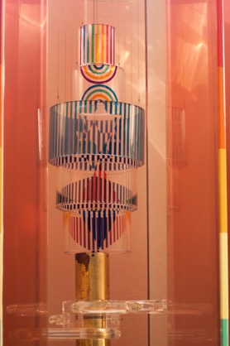
Agam-designed Eternal Light and ark in the Bochner sanctuary

Slide 15
Thanks to each architect and artist who contributed.
E. Stewart Williams, original architect
Donald Wexler, Liberman chapel furnishings
David Christian, Bochner sanctuary
Eric Ray, stained glass windows in chapel
Victor Ries, Hebrew lettering in chapel
Yaacov Agam – Israeli artist, sanctuary ark and art

Slide 16
“How goodly are your tents, O Jacob”
The beauty of the Bochner sanctuary is underscored by the music and words of praise uttered by the biblical Balaam. (Numbers 22:1-35)
Sent to curse the Israelites, Balaam is instead overcome with awe at God and the Israelites' houses of worship.
This music is used to begin many sacred services.

Slide 17
View, looking east, of the Bochner sanctuary and its panoramic window

Slide 18
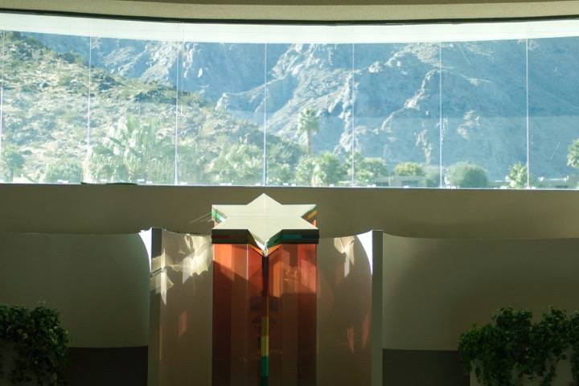
The Bochner sanctuary with its inspiring mountain view
“I lift up my eyes to the mountain from whence my help shall come.” (Psalm 121:1)

Slide 19
The Agam ark is the central focus of the Bochner sanctuary

Slide 20
Agam’s art on the south wall complements the ark

Slide 21
Agam art on the south wall of the Bochner

Slide 22
Agam designed and signed the ark
The ark is a glass and acrylic creation that sets the color tone for the sanctuary and its furnishings

Slide 23
The Agam Eternal Light plays on the colors of the ark.
The six pointed Star of David.

Slide 24
Agam in his own words
“The most daring innovations in technology and electronics should be employed to enhance our worship experience. The Eternal Light I created for the synagogue at the Palm Springs Jewish Community Center is controlled by computer, and the ark is engineered so that the Torah scrolls can be made to "disappear'' when a non-religious activity is performed.”

Slide 25
The Agam ark sets the color scheme for seating
Agam is noted for his use of color and graphic innovation.

Slide 26
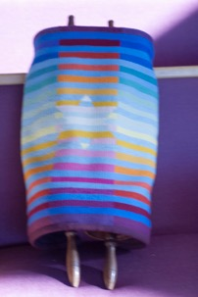
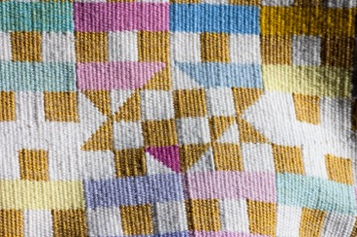
Torah scroll covers with Agam color scheme

Slide 27
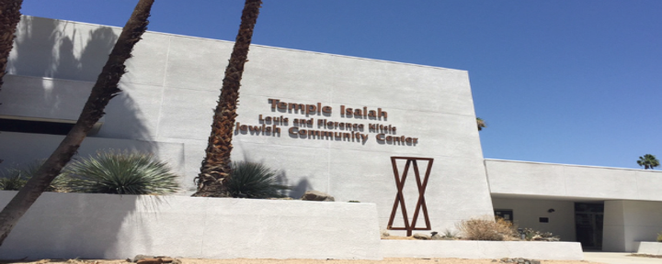
The Temple as a community center
Leonard Cohen’s “Hallelujah” echoes the sacred purpose.

Slide 28
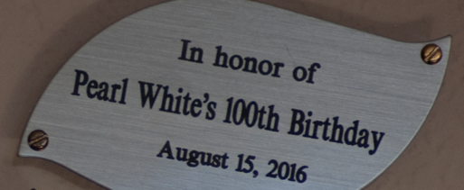
Life moments are celebrated

Slide 29
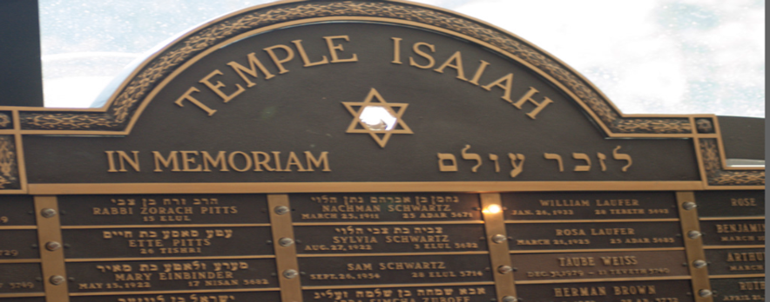
Lives are remembered

Slide 30
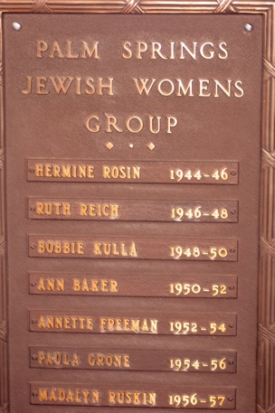
Leaders are remembered

Slide 31
Multi-purpose use of chapel in the 1950’s

Slide 32
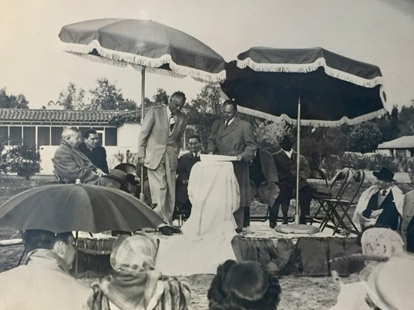
Dedications

Slide 33
The 1960 dedication of the expanded school wing. Mayor Frank Bogert attended.

Slide 34
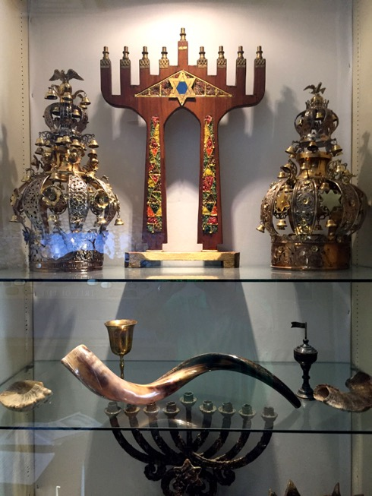
Highlighting Jewish ceremonial objects:
Torah crowns
A shofar

Slide 35
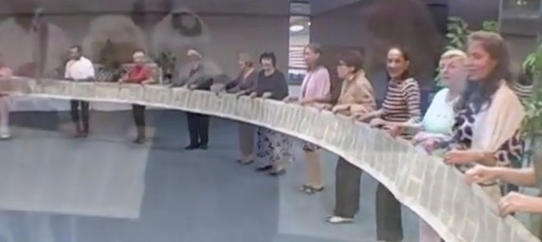
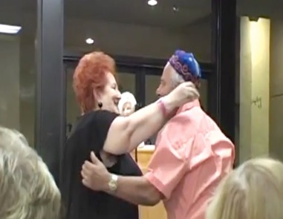
Simhat Torah - celebrating the Torah

Slide 36
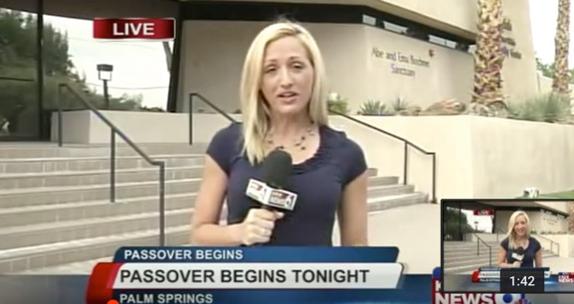
Passover Seder in the Warsaw Ballroom

Slide 37
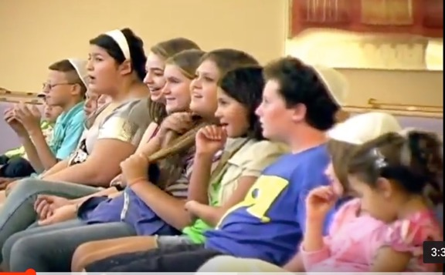
And you shall teach them diligently!

Slide 38
A musical celebration in the Bochner sanctuary

Slide 39
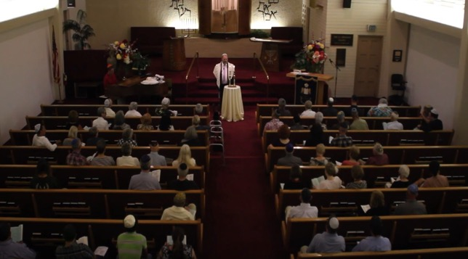
At worship in the chapel
and the sanctuary

Slide 40
Celebrating the lights of Chanukah with Rabbi Lazar

Slide 41
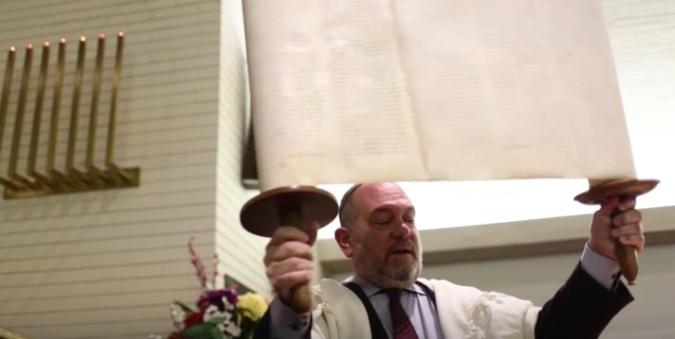
Rabbi = Torah teacher

Slide 42
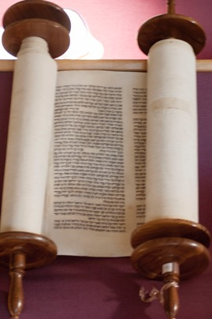
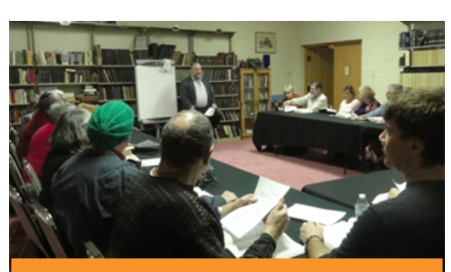
Jewish wisdom from Torah to books

Slide 43
Gay Men’s Chorus in the Bochner sanctuary

Slide 44
Planning an event in the Warsaw Ballroom

Slide 45
Quinceanera party in the Warsaw Ballroom

Slide 46
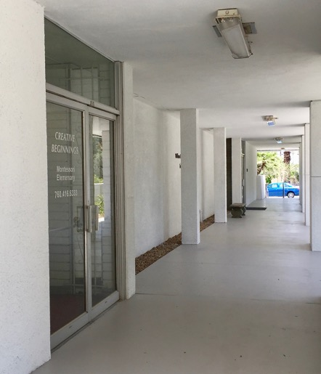
Hosting educational activities

Slide 47
Architecture in the service of the spiritual and sacred
Our Torah scrolls, with their words in ink on parchment, connect us with ancient times.
Our architects and artisans connect us with Modernism and beyond.
Our sacred spaces enhance our contemporary spiritual life.
Thank you for coming to our Modernism Week tours.

